Slide 1


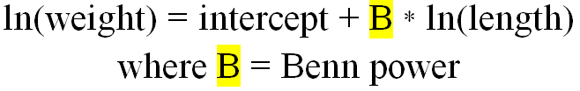
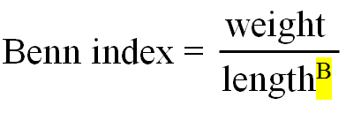
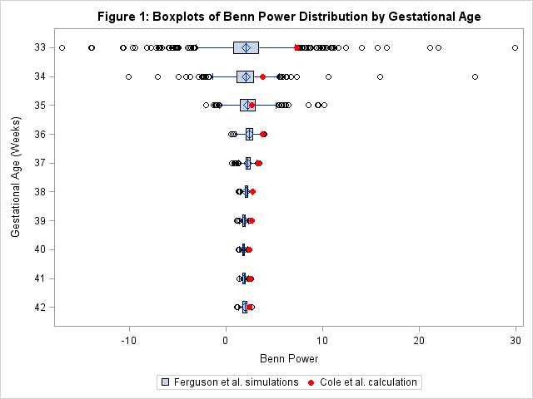
The Optimal Clinical Measure of Preterm Infant Proportionality Wendy Ballew & Jeffrey Chou
BACKGROUND
Faculty Advisors: Dr. Louise Lawson, Dr. Nicole Ferguson
Department of Statistics & Analytical Sciences
CONCLUSIONS
In neonatal intensive care units (NICUs), clinicians noticed that infants were being misclassified as small for weight when they appeared overweight for their length (“bowling ball babies”). Healthy babies have a body weight proportional to their length; they are not too fat or too thin. So, what is the best measure for clinicians to access preterm infant body proportionality?
A Benn power is used to determine the preferred measure of body proportionality. It controls for length, allowing for a measure that accurately represents fat percentage. The power is obtained as a coefficient from the following regression model:
Afterwards, the Benn power is utilized in the following equation for final determination of body proportionality:
In adults, the Benn power rounds to 2 (Body Mass Index). In preterm infants, the best power has been unclear.
The results of the sampling experiment indicate that the Benn powers of Cole et al’s study are entirely plausible given the small sample size and fall within the normal sampling distribution for each gestational age. However, there is an overall trend of slightly larger Benn powers in Cole’s original study that is not explained by sample size or the smaller physical size of the infants.
Ultimately, even when the Ferguson study’s data is sampled to replicate Cole’s data, BMI is the optimal measure. Thus, clinicians should use BMI to measure infant body proportionality.
Table 1: Descriptive Statistics of the Two Studies and the Sampling Distribution of the Benn Power
 | Results from the 1998-2006 sample (Ferguson et al.) |  | Results from the 1987-1988 sample (Cole et al.) |  | Results from the 1,000 samples simulating Cole et al. 1988 sample using Ferguson et al. 1998-2006 data
Gestational Age (weeks) | N | Benn Power | N | Benn Power | Minimum Benn Power | Median Benn Power | Maximum Benn Power
33 | 9,200 | 2.1 | 3 | 7.3 | -17.0 | 2.1 | 29.9
34 | 13,227 | 2.0 | 5 | 3.8 | -10.1 | 2.1 | 25.8
35 | 12,034 | 2.2 | 6 | 2.7 | -2.1 | 2.2 | 10.1
36 | 11,701 | 2.3 | 24 | 3.8 | 0.6 | 2.4 | 4.0
37 | 11,064 | 2.2 | 50 | 3.4 | 0.6 | 2.3 | 3.4
38 | 14,541 | 2.0 | 132 | 2.8 | 1.3 | 2.1 | 2.8
39 | 14,302 | 1.8 | 184 | 2.7 | 1.1 | 1.9 | 2.5
40 | 12,764 | 1.8 | 276 | 2.4 | 1.3 | 1.8 | 2.4
41 | 4,444 | 1.8 | 213 | 2.5 | 1.4 | 1.9 | 2.6
42 | 643 | 1.9 | 92 | 2.4 | 1.1 | 1.9 | 2.7
SAMPLE SAS CODE
%macro samples();
*Take 1,000 samples stratified by gestage weighted toward smaller BMI infants;
%do i=1 %to 1000; %let d1=trial&i.;
%let d2=ParEstallresponse&i.;
proc surveyselect data=gbg.csboysgirlsSUB
method=pps sampsize=(3 5 6 24 50 132 184 276 213 92) out=trial&i.; size recBMI; strata gestage; run;
*Regression model to calculate Benn powers;
proc reg data=&d1;
model lnweight=lnlength; by gestage;
ods output parameterestimates=ParEstallresponse&i; run;
*Extract GestAge and Benn powers from reg. output;
data benn&i.;
set &d2;
if variable = "Intercept" then delete;
bennallresponseest = estimate;
keep gestage bennallresponseest; run;
%end; %mend;
%samples()
*Initiate concatenation of benn power datasets;
data gbg.FINAL; set benn1; run;
*Run concatenation of benn power dataset;
%macro concat();
%do i=2 %to 1000;
%let d1=benn&i.;
data gbg.final;
set gbg.final &d1; run;
%end; %mend; %concat()
*Create boxplot with scatterplot overlay;
proc sgplot data=gbg.cole2;
hbox Benn_Power / legendlabel="Ferguson et al. simulations" category=GestAge;
scatter y=GestAge x=Benn_Power_Cole / legendlabel="Cole et al. calculation"
markerattrs=(color=red symbol=circlefilled size=8);
title "Figure 1: Boxplots of Benn Power Distribution by Gestational Age";
xaxis label="Benn Power";
yaxis label="Gestational Age (Weeks)";
run;
THE PROBLEM
Cole et al. (1997) found that the Benn power of a sample of preterm infants is around 3 (the ponderal index), whereas a more recent study (2015) by Ferguson et al. found a Benn power of 2 (the body mass index, or BMI). Clinicians need a single accurate measure of preterm infant body proportionality; should they use BMI or ponderal index?
The recent study was from a dataset of 103,920 infants in the NICU (aged 22 to 42 weeks) collected between 1998 and 2006 from 248 hospitals around the United States, whereas Cole et al’s study used a single hospital's data of 998 infants from England that was collected from 1987 to 1988.
Medication usage, gender, race, calendar year, and survival status were analyzed but none explained the differences in Benn power between the two studies. Thus, we hypothesized that the disparity between these two datasets is due to physical differences in the infants and extreme sample size differences.
THE CURRENT STUDY
First, we compared the mean BMI and ponderal index by gestational age from the Ferguson et al. versus the Cole et al datasets. It was found that in the Cole at al. study, both the mean BMI and ponderal index were smaller than in the more recent sample.
We then designed a macro in SAS to take 1,000 samples at each gestational age of preterm infants from the 1998-2006 study in order to determine a sampling distribution. Each sample size was specific to sample sizes by gestation age as used in the Cole study, leading to a total sample size of n=985. In addition, the sampling procedure was weighted towards infants with smaller BMIs.
For each sample, the macro runs the regression equation shown above to calculate the Benn power for each gestational age. The results obtained from each sample are concatenated into one final dataset, which then can be used for analysis.

